Slide 1
Lab4 AI Security

Slide 2
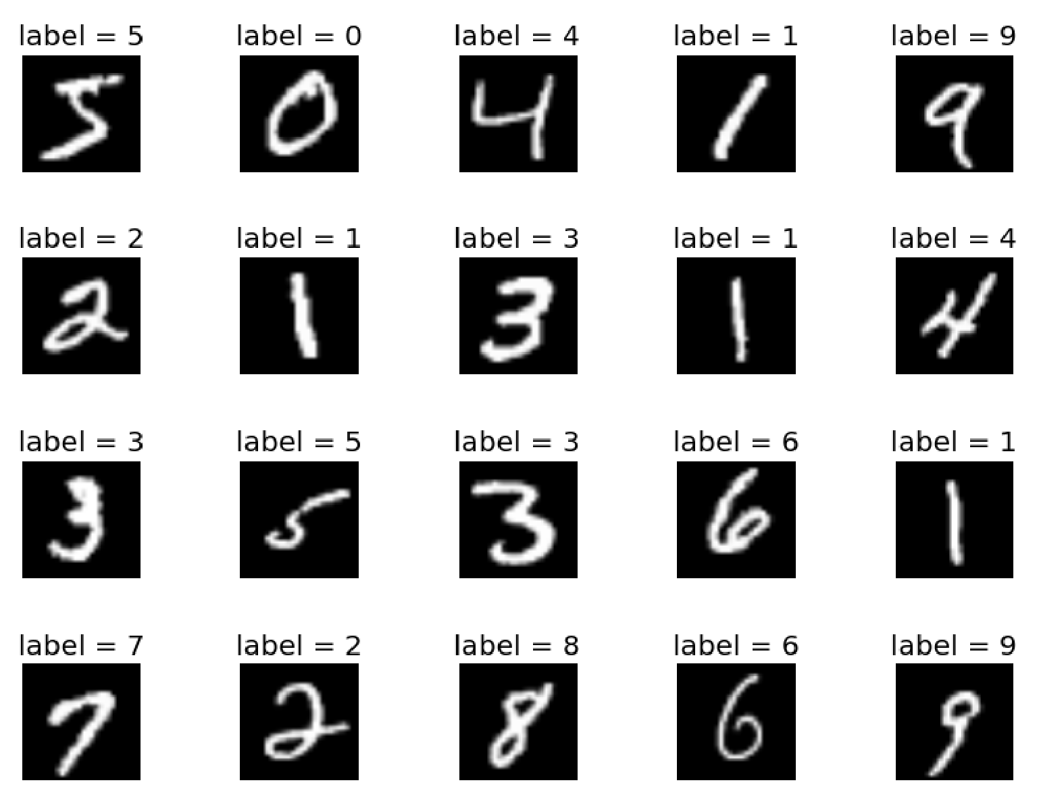
Environment
Pytorch
A widely used DNN model training and inference framework
Dataset
MNIST: Classify hand written digit images.

Slide 3
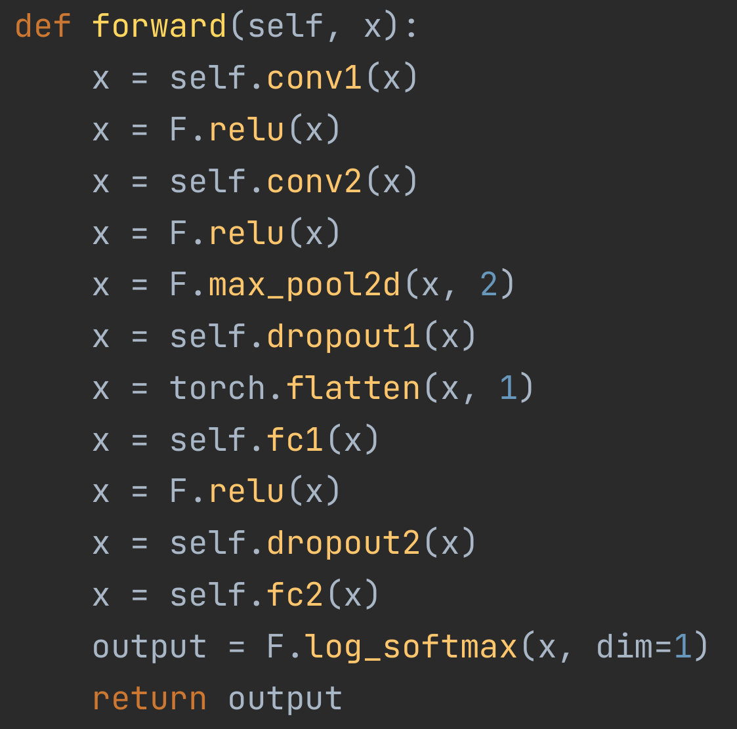
Model Structure
Dropout: randomly turn off some neurons
To reduce overfitting
Forcing the network to learn more robust and generalizable features
2 conv + pooling + 2 fc + softmax
n*n*1 -> n*n*32 -> n*n*64 -> n/2*n/2*64
-> 9216 -> 128 ->10

Slide 4
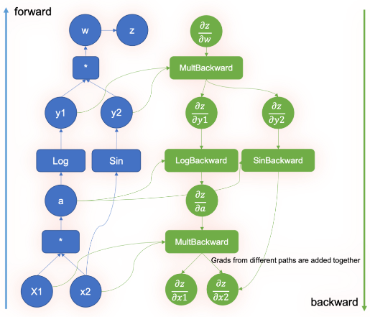
Pytorch Autograd
When defining the model, developers actually are defining a compute graph in the forward function.
For each operator, gradient calculation was defined in the backward function.
Pytorch automatically construct the graph for gradient according to the graph
By using loss.backward(), you get the gradient from loss to each tensor.
By calling optimizer.step(), pytorch apply the gradient to each tensor storing weights.
You may get the gradient from loss to x by x.grad, after loss.backward().

Slide 5
Model Training
Use model.py
batch size set to 64
learning rate set to 0.001
loss: nll_loss (negative log likelihood loss, or cross entropy loss with one-hot label)
6 epochs
In few minutes, you get the a usable model
with above 99% accuracy.

Slide 6
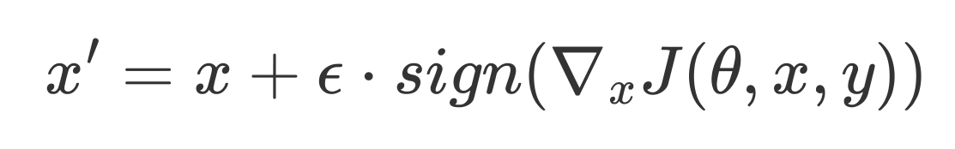
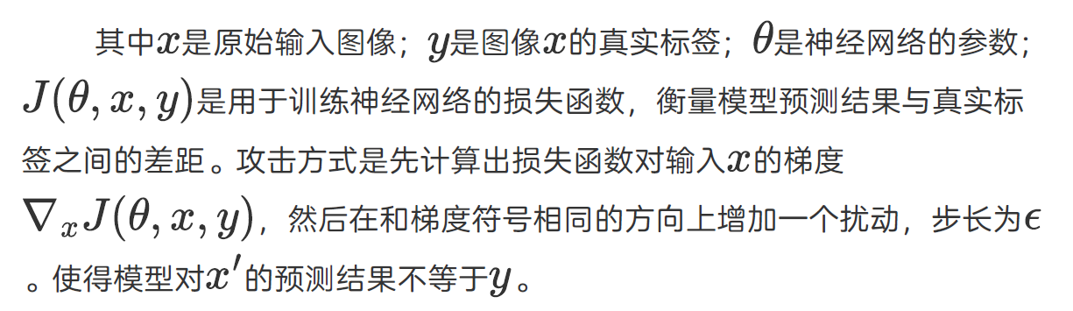
Task 1 Adversarial Examples
Algorithm: FGSM
Get the sign of the gradients from loss to input.
Add the gradients to input x as perturbations.
ε as the bound on perturbation

Slide 7
Task 1.1 untargeted attack
Goal: the output class to be wrong
Requirements:
ε <= 0.05
acc. below 5%
Design:
The loss is the same as the training loss
When training, decrements the parameters by the loss
When adversarial learning, increment the input by the loss

Slide 8
Task 1.2 targeted attack
We want the model to output given wrong class (target), rather than randomly classes.
Still use FGSM
Different loss:
like training, minimize the loss from the probability (target class) to input

Slide 9
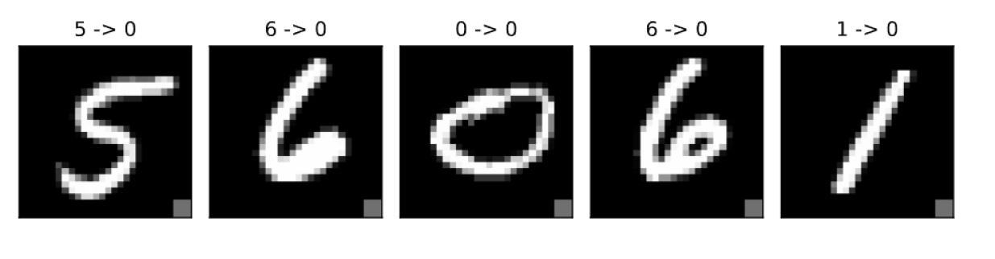
Task 2: Backdoor
Try modify a portion of training data.
Portion: η
Add a trigger in the training picture at fixed position
Make the output class always 1
Goal:
η: 1%
accuracy: 95%

